Slide 1
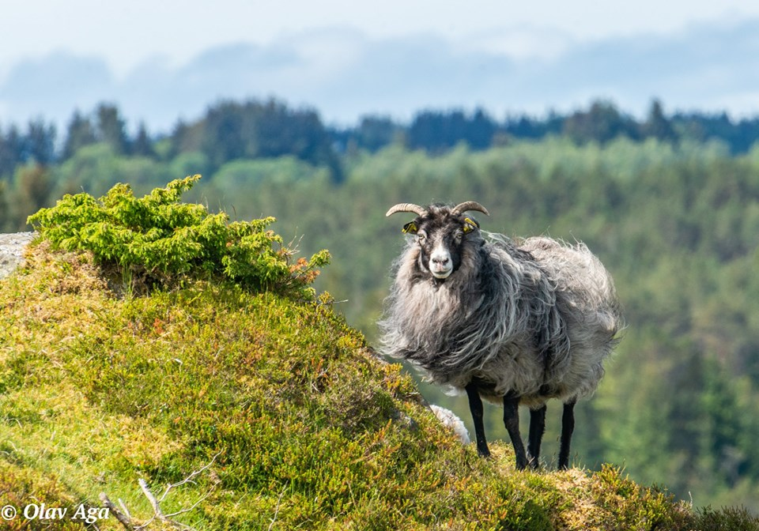
Heritage tour in the Unesco Biosphere area
By boat from Bergen
Join us on this unique tour in the spectacular coast of Bergen county with its fantastic coastal landscape. We travel by boat, under bridges and through the magic streams . The focus in this tour is WOLL. You visit The heathlands at Lygra and The Western Norway Emigration Center.
Departure: Dreggekaien Bergen
Duration: 7 hours
Price: On request (minimum 20 pax)
Booking: tel 0047 406 77 249 / www.westseashipping.com

Slide 2
The heathlands at Lygra
Listen to the long story from the Vikings. Graves, hiking trails, local food, film and exhibitions are examples of what you can experience. Lunch is included and made from local food.
THE MAGICAL STREAMS
Get a beautiful boatcruice in a fantastic nature.
It may look like a river at some times, tight and narrow, but it is the magical streams of western Norway with its deep blue water and bright small green islands and shores.
Come experience it with us!
Old Norwegian Sheep, wildsheep
Outdoor you can watch the wildsheep graze all year round. In the museumshop you can buy varios short-traveled wollen products.
The Western Norway Emigration Center- the original Prairie Village from America
It is relocated and buit up on Sletta. You can see how the emigrants lived their lives in America.There is also a museum of migration and culture meeting in the past and present.

