Slide 1
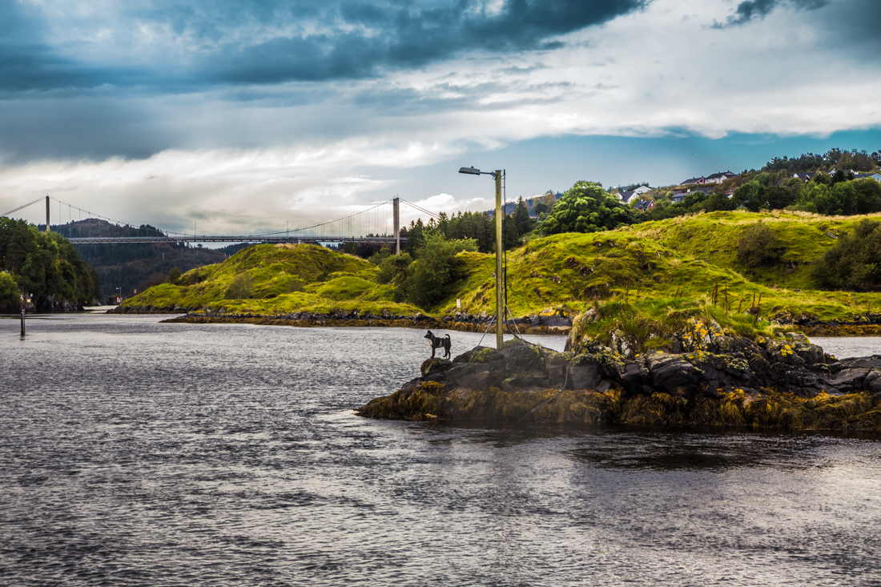
The inner coast line
Experience the magic streams
Join us on this unique tour in the spectacular coast of Bergen county with its fantastic coastal landscape. We travel by boat, under bridges and through the magic streams .
Departure: Dreggekaien Bergen
Duration: 3 hours
Price: On request (minimum 20 pax)
Booking: tel 0047 406 77 249 / www.westseashipping.com

Slide 2
GET CLOSE TO THE NATURE
Get a beautiful boatcruice in a fantastic nature. You simply cannot get closer to the nature than this!
THE MAGICAL STREAMS
It may look like a river at some times, tight and narrow, but it is the magical streams of western Norway with its deep blue water and bright small green islands and shores.
Come experience it with us!
A TRIP FOR EVERYONE.
This boatcruice is something for everyone. It is easy to get on the boat, it is 3 hours tour.
You can buy coffe, cold bevereges and light snacks on the boat.
THE MOST WESTERN POINT OF NORWAY.
On this magical journey you will also get to see Vardetangen, the most western point of Norway. A beautiful and popular destination for people who enjoy walking and recreation outdoors.

